Slide 1

Restaurant Order and Management Website
GRADUATION THESIS
Student: Le Thanh Chinh
Supervisors: MSc Le Ba Vui

Slide 2

Table of contents
Introduction
Objectives & Features
System design
Solution & Contribution
Conclusion & Future work

Slide 3
01
Introduction

Slide 4

1. Introduction
- A growing population leads to an increasing need for food
=> More and more restaurants are being built
=> Difficulty in restaurant management

Slide 5
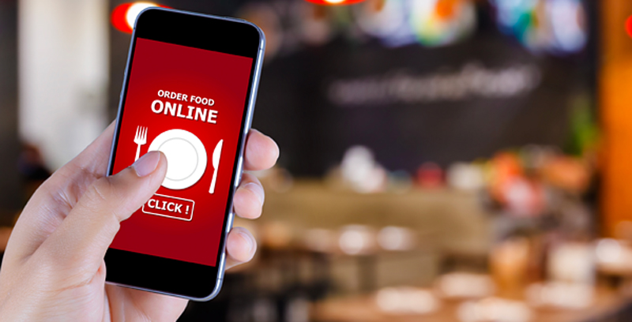
1. Introduction
- Customers increasingly prefer to use online services to reserve tables, order food and pay
- Restaurants need to increase operational efficiency, improve customer satisfaction, reduce errors, and reduce decision-making.

Slide 6
02
Objectives & Features

Slide 7
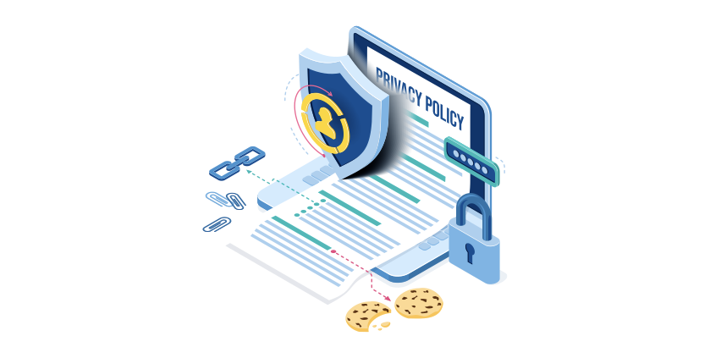



2. Objectives & Features
2.1 Objectives
Building a restaurant management and ordering website aims to:
Provides a convenient management system for management
Minimize operating costs and optimize processes.
Manage customers and promotions and apply discounts.
Provides online ordering, table booking and payment functions for customers

Slide 8
2. Objectives & Features
2.2 Features
Main features of admin:
Main features of customer:
1. Manage product
2. Manage order
3. Manage user
4. Manage discounts
5. Manage table reservations
6. Manage blog
Manage shopping cart
View products
Book table
Order
Read blog

Slide 9
03
System design

Slide 10
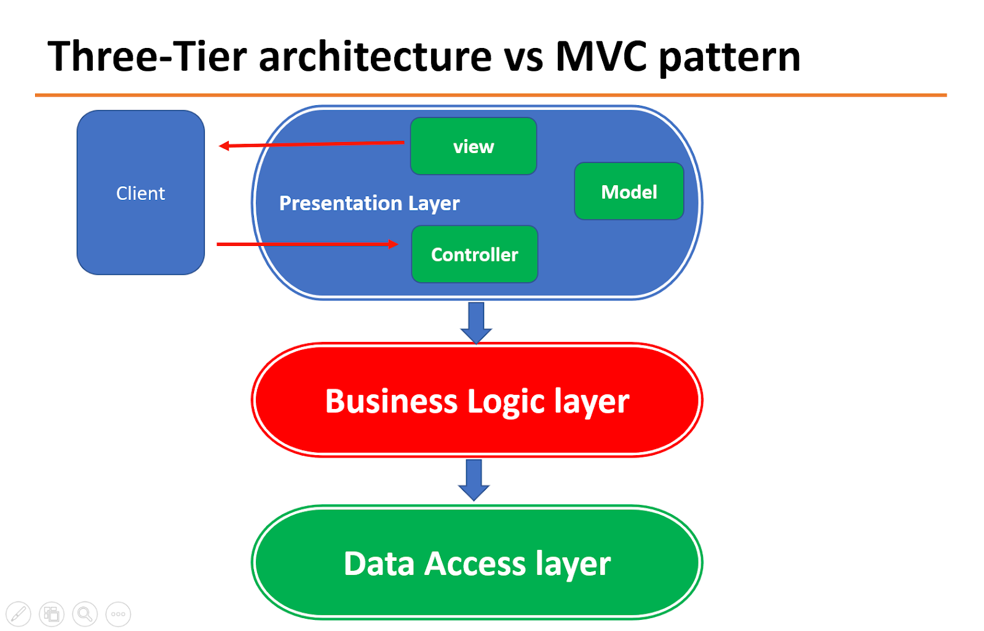
3. System design
3.1 Architecture design
The website is designed according to an architecture combining three tier and MVC models Combining the two models, we get a complete Spring Boot application

Slide 11
3. System design
3.1 Architecture design
First, View sends a request to Controller. Controller receives the request, then sends the request to Service
2. Service receives a request from the Controller, the Service call the Repository to retrieve data
3. The Repository receives a request from the Service and will connect to the database. Data retrieved from the database is mapped into objects by the system (Entities). Then Repository returns the data to the Service
4.Service receives the Entities returned by Repository and transforms them into Models. The Model will be returned to the Controller.
5. Controller return to View.

Slide 12

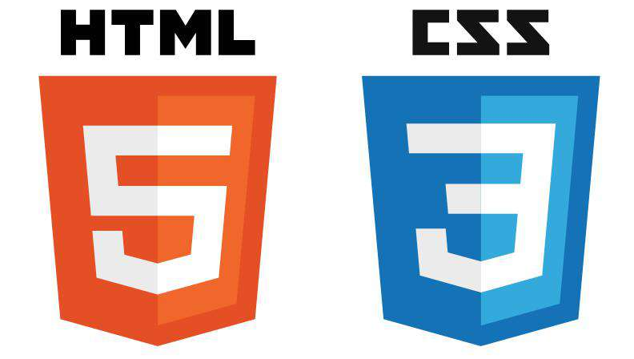
3. System design
3.2 Adopted Technology
Frontend

Slide 13




3. System design
3.2 Adopted Technology
Backend

Slide 14
04
Solution & Contribution

Slide 15
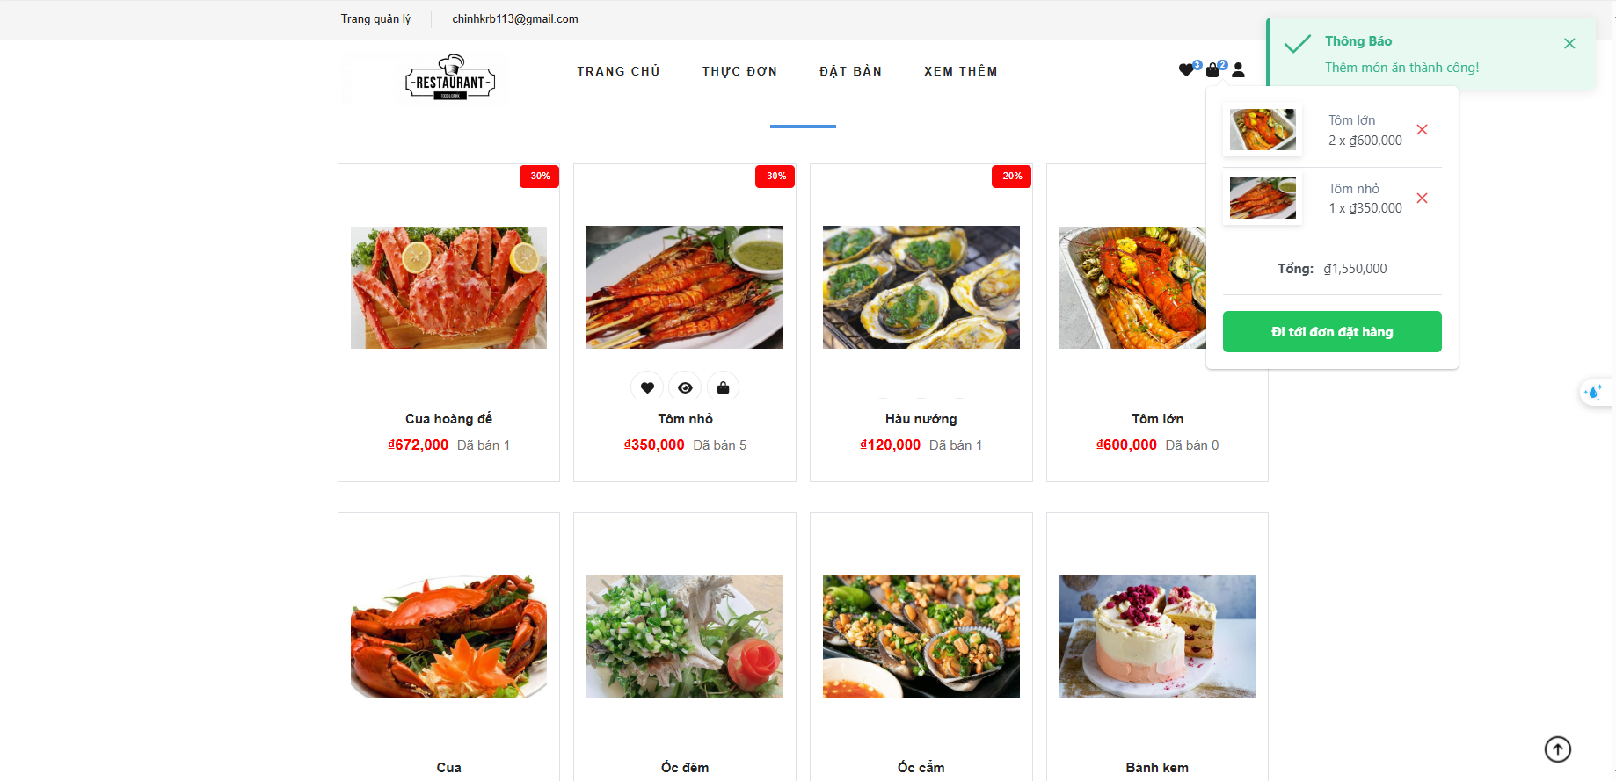
4. Solution & Contribution
4.1 The interface is easy to use and convenient to use
The interfaces bring convenience and friendly to users.
Website uses a simple, straightforward, easy-to-use interface, Website will help users have no difficulty the first time using it.

Slide 16
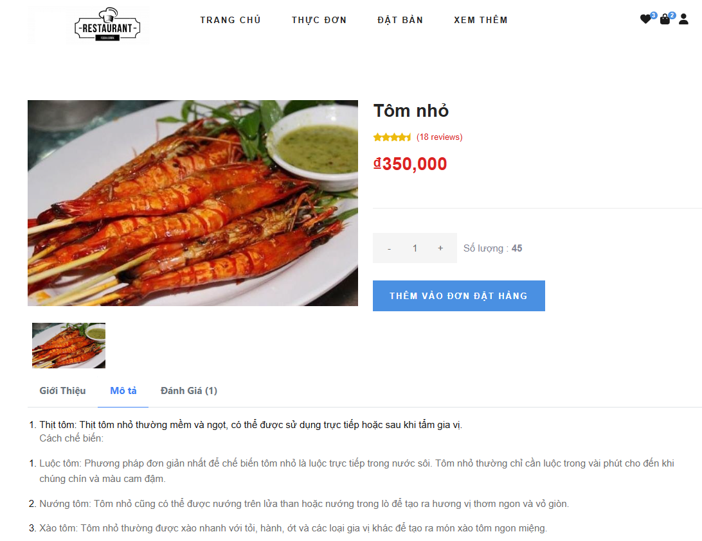
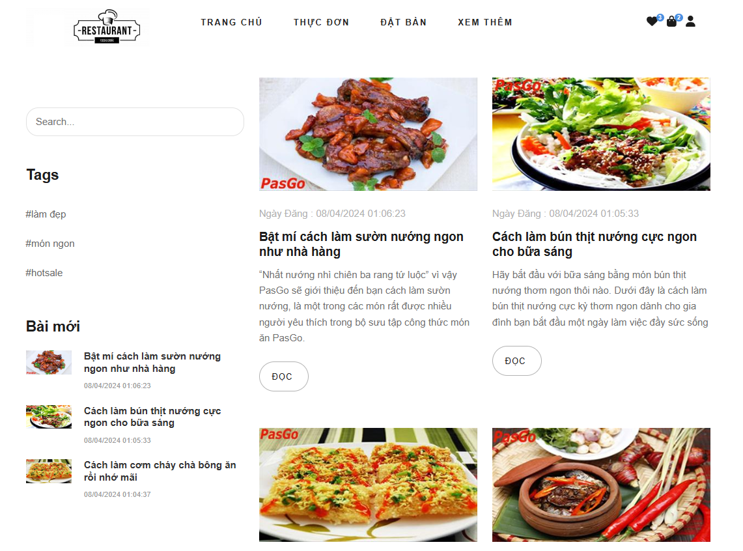
4. Solution & Contribution
4.1 The interface is easy to use and convenient to use
Functions and content are displayed clearly and specifically, without overlapping other content.
Detailed dish interface
Blog viewing interface

Slide 17
4. Solution & Contribution
4.2 Secure sensitive data
- Problem
Protect users' personal data
Minimize loss of sensitive data in database leaks.
- Solution
JWT
Use Bcrypt

Slide 18
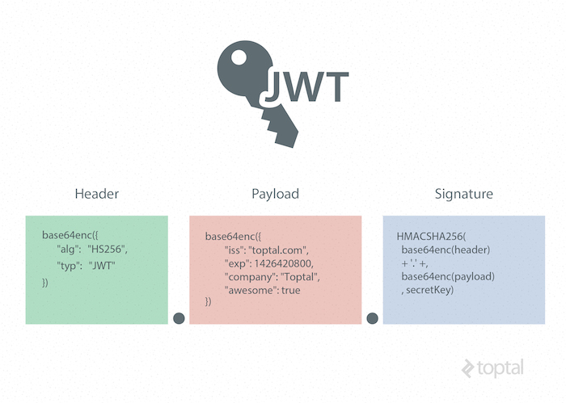
4. Solution & Contribution
4.2 Secure sensitive data (JWT)
JWT is used to securely authenticate users.
• Authorization and access management
• Avoid using cookies
• Extensibility and integration
• Time-based constraints
• Data integrity

Slide 19
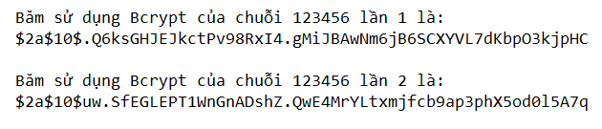
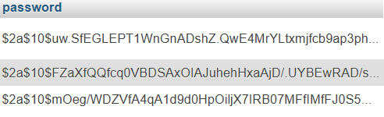
4. Solution & Contribution
4.2 Secure sensitive data (Bcrypt)
The ciphertext is different when hashing the same plaintext
Data is encrypted almost randomly in the database

Slide 20
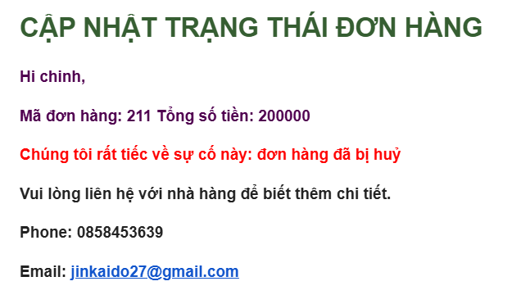
4. Solution & Contribution
4.3 Email System
With the necessary information, the system will automatically send an email to the customer
Order cancellation email

Slide 21
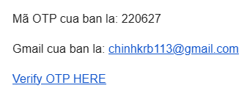
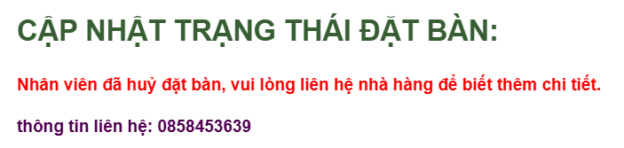
4. Solution & Contribution
4.3 Email System
Email OTP
Cancel reservation email

Slide 22
4. Solution & Contribution
4.4 Statistical
In restaurant management, using statistics not only helps improve operational efficiency but also brings many different benefits.
Statistics provide an overview of business activities, thereby helping managers make accurate and timely decisions.

Slide 23
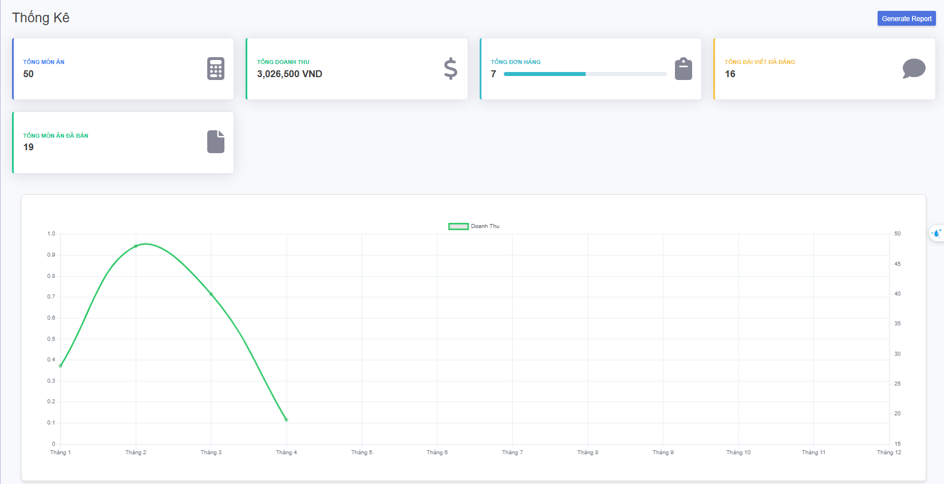
4. Solution & Contribution
4.4 Statistical
Interface of the statistics page

Slide 24
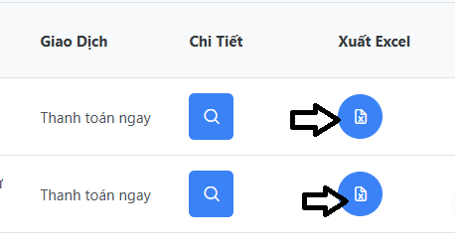
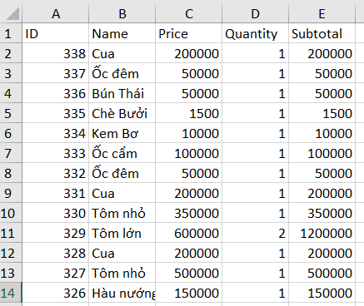
4. Solution & Contribution
4.4 Statistical
Interface of the statistics page

Slide 25
05
Conclusion & Future work

Slide 26
5. Conclusion & Future work
5.1 Achievements acquired
- System Overview:
Provides management functions such as: dish management, order management, user management, statistics
Providing convenient functions for customers such as: booking tables/dishes online, reading blogs, viewing restaurant information
- Achievements:
Improve programming skills in Java, Typescript, SQL
The graduation project helped me gain practical access to the specific profession of Restaurant Management and build a complete system.

Slide 27
5. Conclusion & Future work
5.2 Limitations
- The user interface is not eye-catching
- Some features are not well developed such as advanced analytics and statistics.
5.3 Future work
- Improving user interface
- Adds advanced analytics and statistics features
- Optimize the website for performance and user experience as well as website services.
- Integrate new technologies into the system.

Slide 28
THANK YOU !

